Slide 1
بسم الله الرحمن الرحيم
Qassim University
Coolege of Computer Scince
Specialization-Science in Information Technology
Research Title:
Application Programming Interface (API)
Design and Management-(REST*GraphQl*gRPC)
Prepared by Student:
Dafaallh Alrayh Mustafa
Supervisor:
Dr.Abdulaziz saleh

Slide 2
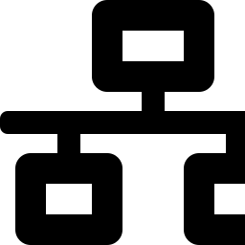


Introduction:
The Shift Toward Connected Systems:
The rapid advancement of information technology has led to the emergence of more complex software systems that rely on integration and communication between many different applications and services. In this context, Application Programming Interfaces (APIs) have become an essential element in modern system design, as they provide an organized way to communicate and exchange data between applications without needing to know the internal details of each system.
A Connecting Link
Separation of Components
Comprehensive Design
The API acts as a connecting link between the client and the server, receiving the request and returning the result after processing.
This approach separates the system's components, making it more flexible and easier to develop and maintain.
API design isn't just about linking applications together — it also covers resource organization, performance, and security.
2

Slide 3
What is an API?
API stands for Application Programming Interface — a set of rules and mechanisms that allow one application or system to communicate with another without needing to know the internal details of how the other system is implemented.
API is generic, and there are kinds of APIs:
Web APIs
Accessed over HTTP. This is what REST and GraphQL are styles of.
Library/framework APIs
The functions and classes a library exposes, like Math.max() in JavaScript or requests.get() in Python.
Operating system APIs
  How programs ask the OS to open files, draw windows, or use the network.
Hardware/driver APIs
How software talks to devices like cameras or GPUs.
3

Slide 4

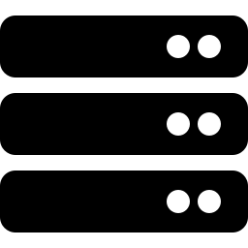
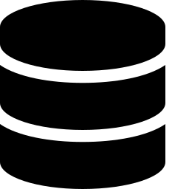
What is an API?
API stands for Application Programming Interface — a set of rules and mechanisms that allow one application or system to communicate with another without needing to know the internal details of how the other system is implemented.
In simple terms: an API acts as an intermediary between the client and the server
Client
API
Server
Database
The application the user interacts with
Receives requests and organizes communication
Executes the system logic
Holds the information
3

Slide 5
API Types Based on Accessibility:
1-Public API:
Available to external developers or users according to the API providers
terms and conditions.
-Example : Weather API or Maps API.
2-Private API:
Used within an organization to connect internal systems, applications,
and services.
-Example: An HR system communicates with the payroll system.
3-Partner API:
Available only to selected business partners through authorization or
an agreement.
-Example: A delivery company uses an online stores API to receive
delivery orders.

Slide 6


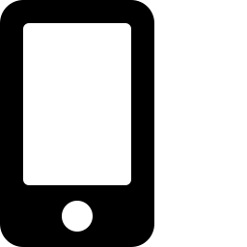

Why is an API Important?
Integration Between Systems
Reusability of Services
APIs make it easy to connect different systems and applications with one another.
A single service can be developed and used by multiple different applications.
Separation of System Components
Support for Multiple Applications
Separates the user interface from business logic and the database, for a more organized system.
The same API can serve a mobile app, a website, and other applications at once.
Improved Scalability
Good API design helps add new services without rebuilding the entire system.
4

Slide 7
Practical Example:
How Does an API Work? — E-commerce Example
Suppose a user wants to view the product list in an e-commerce app:
1
2
3
4
The store app sends a GET/products request to the API
The API receives the request and sends it to the server for processing
The server accesses the database
Data is returned: Database → Server → API → Client
Result: the user sees, for example — Laptop, Smartphone, Headphones — without needing to know how the data is stored or how queries are executed internally.
Laptop
Smartphone
Headphones
5

Slide 8
HTTP
HTTP is the protocol that defines how clients and servers exchange messages on the web.
A browser sends an HTTP request to a server, and the server sends back an HTTP response.
How it works
Request-response:
The client always initiates, the server replies.
Stateless:
  Each request is independent, and the server doesn't remember previous ones.
  Things like cookies, sessions, and tokens are layered on top to keep track of who you are.
It runs on top of TCP (or QUIC in HTTP/3), usually on port 80.
6

Slide 9
Basic Operations in an API:
Many APIs rely on basic HTTP operations to handle data:
GET
POST
PUT
DELETE
Retrieve data
Create new data
Update existing data
Delete data
GET /products
POST /products
PUT /products/10
DELETE /products/10
Get the list of products
Add a new product
Update product #10
Delete product #10
6

Slide 10

Simplified Use Case Diagram of How an API Works:
API System — Server
Send Request
1
Receive and route the request
2
Process the operation on the server
3
User
(Client)
Access the database
4
Return the Response
5
The diagram simplifies the client's interaction with the system: it starts with a Request from the user and ends with a Response, after passing through the API, the server, and the database.
7

Slide 11
What is REST?
REST stands for Representational State Transfer, a very common architectural style for designing Web APIs.
REST relies primarily on the HTTP protocol, treating the data in the system as Resources that can be accessed using URLs and HTTP operations.
The core idea is that everything is a resource (a user, an order, a post) identified by a URL.
Example in an e-commerce store:
GET /products — to get the products
GET /products/10 — to get a specific product
POST /products — to create a new product
DELETE /products/10 — to delete a specific product
8

Slide 12
How Does a REST API Work?
Request:
Client
HTTP Request
REST API
Server
Database
Response:
Database
Server
REST API
HTTP Response
Client
Data is typically exchanged using JSON format, allowing a mobile app or website to read and use the data.
Example JSON response:
{ "id": 10, "name": "Laptop", "price": 3500 }
9

Slide 13

Key Characteristics of REST:
Stateless
Resource-Based
Every Request must contain the information needed to process it; REST does not rely on storing client state between requests.
REST treats data as resources, such as: Users, Products, Orders, Payments.
Uses HTTP
Scalability
REST uses HTTP's basic operations, such as: GET, POST, PUT, DELETE.
Statelessness helps build systems that can scale and handle a large number of requests.
10

Slide 14

Advantages and Disadvantages of REST:
Advantages:
Disadvantages:
Easy to understand and learn
Over-fetching: more data than needed
Direct use of HTTP
Under-fetching: multiple requests for different resources
You need several requests to assemble one screen (for example, user, then their posts, then each post's comments
Easy integration with web and mobile apps
Many endpoints in large systems
Wide support from programming languages and tools
Limited flexibility for the client in choosing data
Easy to test with tools like Postman
Good scalability
11

Slide 15
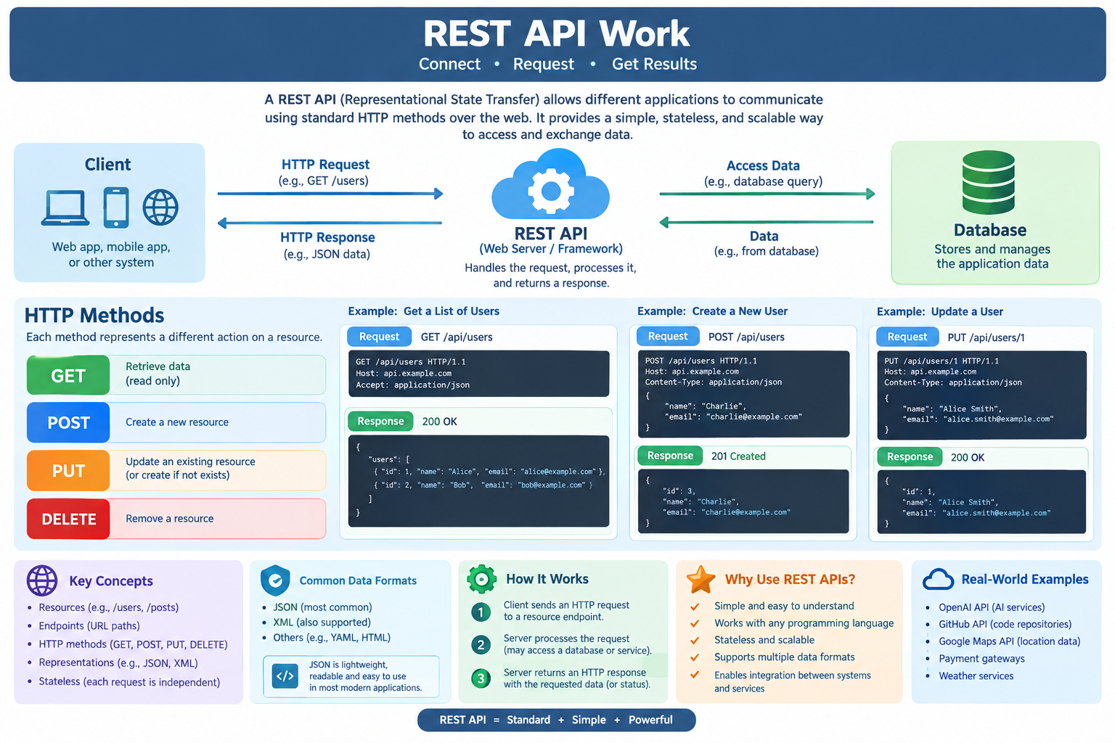

Slide 16
What is GraphQL?
GraphQL is a query language and runtime used to build APIs, letting the client specify exactly the data it needs.
Instead of the API relying on a large number of endpoints, the client can send a single query that precisely specifies the required data.
Example:
In this case, the client requests only:
query {
Product name
product(id: 10) {
name
Price
price
}
This gives the client greater flexibility in specifying the required data, with no more and no less.
}
12

Slide 17
What is GraphQL?
A GraphQL query is just an HTTP request.
At its simplest, POST JSON with a query field (and optional variables) to the server's single endpoint.
const query = `
query GetUser($id: ID!) {
user(id: $id) {
name
posts { title }
}
}
`;
const res = await fetch('http://localhost:4000/', {
method: 'POST',
headers: { 'Content-Type': 'application/json' },
body: JSON.stringify({ query, variables: { id: '1' } }),
});
const { data, errors } = await res.json();
console.log(data.user.name);
js
curl -X POST http://localhost:4000/ \
-H "Content-Type: application/json" \
-d '{"query":"{ posts { id title } }"}'

Slide 18

How Does GraphQL Work?
Client
Graphql Query
GraphQL API
Server
Data base
Only the requested data is returned via the same path in the opposite direction (Database → Server → GraphQL → Client).
The key feature here is that the client — not the server — determines the shape of the requested data in the query.
13

Slide 19
Advantages and Disadvantages of GraphQL
Advantages
Disadvantages
Precise control over the requested data
More complex than REST in some systems
Reduces the over-fetching problem
Requires careful management of complex queries (performance)
Reduces the under-fetching problem
Requires good schema design
Combines data from multiple sources in a single query
Caching is more complex compared to some REST implementations
Suitable for applications with flexible, complex data
A clear schema for data types and operations
14

Slide 20
What is gRPC?
gRPC is a Remote Procedure Call framework developed by Google, widely used for communication between services in distributed systems and microservices environments.
gRPC relies on HTTP/2 and typically uses Protocol Buffers (Protobuf) to define services and messages. Instead of thinking only in terms of Resources and HTTP Methods, gRPC lets you define operations the client calls directly on the server.
Defining a service using a .proto file:
service ProductService {
rpc GetProduct (ProductRequest) returns (Product);
}
This means there is a service called ProductService containing an operation called GetProduct.
15

Slide 21

How Does gRPC Work?
Client
gRPC Request
Service
Server
The client starts by calling a remote procedure
The request is sent over HTTP/2 in Protobuf format
The service determines the operation to be executed
The server executes the operation and returns
The result then returns via the reverse path: Server → gRPC Response → Client. Services and messages are defined using a .proto file.
Simple example:
service ProductService { rpc GetProduct (ProductRequest) returns (Product); }
16

Slide 22

Types of gRPC Calls
Unary RPC
Client ───── Request ─────► Server
Client ◄──── Response ───── Server
3. Client streaming
Client ───── Student 1 ───► Server
Client ───── Student 2 ───► Server
Client ───── Student 3 ───► Server
Client ───── Student 4 ───► Server
Client ◄──── Result ─────── Server
2. Server streaming
Client ───── Request ─────► Server
Client ◄──── Student 1 ──── Server
Client ◄──── Student 2 ──── Server
Client ◄──── Student 3 ──── Server
Client ◄──── Student 4 ──── Server
4. Bidirectional streaming
Client ───────► Server
◄───────
───────►
◄───────
───────►
◄───────
16

Slide 23
Advantages and Disadvantages of gRPC:
Advantages:
Disadvantages:
High performance
More complex than REST for beginners
Uses HTTP/2
Less convenient for direct use from a browser
Protocol Buffers for an efficient binary data format
Requires special tools and setup for Protocol Buffers
Very suitable for communication between microservices
May not be the best fit for all general-purpose Web APIs
Supports different types of communication, such as streaming
Developers need additional understanding of HTTP/2 and Protobuf
Clear definition of services and messages
17

Slide 24
Comparison:
REST vs. GraphQL vs. gRPC:
Aspect
REST
GraphQL
gRPC
Style
Architectural Style
Query Language + Runtime
RPC Framework
Request Method
HTTP Methods
Queries / Mutations
Remote Procedure Calls
Common Protocol
HTTP
HTTP
HTTP/2
Data Format
JSON
JSON
Protocol Buffers
Flexibility
Good
Very High
Moderate
Performance
Good
Good, depending on the query
High
Ease of Learning
Easy
Moderate
More Complex
Common Use
Web APIs
Flexible, complex data
Microservices
18

Slide 25


Optimal Choice:
When to Use Each Technology?
REST
GraphQL
gRPC
Simple, clear Web API
The client needs to choose its own data
Performance and connection speed matter
Easy integration with different applications
Interconnected, complex data
Communication between microservices
A system based on resources
Multiple applications need different shapes of data
Services need streaming
Easy to develop and test
We need a strong, structured protocol for data exchange
19

Slide 26
Practical Case Study: E-Commerce Platform:
Scenario:
An e-commerce platform supports web and mobile applications and needs APIs to
Communicate with different services.
How the technologies can be used:
REST API:
Products
Orders
Payments
Common operations such as (GET,POST,PUT,DELETE)
GraphQL:
Allows the client to request exactly the data it needs.
Useful when web and mobile applications require different data.
gRPC:
Used for communication between internal services.
Suitable for high-performance communication between microservices.

Slide 27


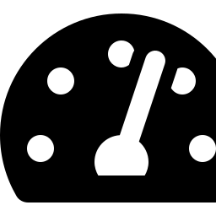

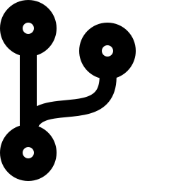
Summary
No single technology is the best choice in every case
REST
GraphQL
gRPC
Simplicity, wide adoption, and easy integration with web applications
Great flexibility for the client in specifying the required data
High performance and efficient communication between microservices
API management doesn't stop at design — it extends to operations, maintenance, and continuous development:
Authentication
Security
Rate Limiting
Monitoring
Versioning
Verifying identity
Protection from attacks
Controlling requests
Tracking performance
Managing updates
The right choice depends on the system's requirements, data volume, required performance, the nature of the communication, and scalability.
20

Slide 28
Classification:
HTTP Status Codes:
Every API response includes a status code that indicates the result of the request, classified into five main categories:
2xx
3xx
4xx
5xx
Success
Redirection
Client Error
Server Error
200 OK
301 Moved
404 Not Found
500 Internal Error
The operation completed successfully and the requested data was returned
The resource has moved, and the request must follow the new address
An error in the request itself, such as a resource that doesn't exist
An internal server failure occurred during processing
22

Slide 29
Documentation:
Documenting APIs — OpenAPI / Swagger:
A unified, clear contract (Schema)
Automatic code generation
OpenAPI describes every endpoint, its data types, and its inputs with full precision.
API clients and SDKs can be generated directly and ready-made from the documentation file.
Interactive experience
Continuous sync with the code
Swagger UI lets you test requests directly from the documentation page.
The documentation stays automatically up to date with every change in the API definition.
Easier integration between teams
Any external team can understand how to use the API without additional explanation.
23

Slide 30
Security:
Authentication and Authorization :
Authentication
Authorization
Verifying the identity of the party sending the request before granting access.
Determining the permissions allowed for each user or role (RBAC).
API Keys
JWT — JSON Web Token
A fixed key sent with the request to identify the application calling the service.
A digitally signed token carrying identity data, verified without returning to the database.
24

Slide 31
Security:
Securing APIs — Best Practices:
Best Practices:
Common Risks:
Enforce HTTPS/TLS on all connections
Code injection (SQL / Injection Attacks)
Strict input validation
Exposing sensitive data in responses (Excessive Data Exposure)
Apply the principle of least privilege
Weak authentication (Broken Authentication)
Securely manage secrets and API keys
DDoS attacks and brute-force attempts
Rate limiting to prevent abuse
Log and monitor suspicious access attempts
25

Slide 32
Management:
API Versions — Versioning Strategies:
URI Path
Header Versioning
Query Parameter
/v1/products
Accept-Version: v2
?version=2
The version number is included in the URL
The version number is included in the HTTP header
The version number is included as URL parameter
Clear and widely used
Keeps the URL unchanged
Easy to switch between versions
27

Slide 33
Performance:
Caching in APIs:
1-Cache-Control Headers
2-ETag and Conditional Requests
Cache Duration
Specifies how long cached data remains valid.
Data Validation
Checks if data has changed before downloading.
3-CDN — Content Delivery Network
4-Browser or Client-Side Caching
Faster Access
Stores data closer to users for faster access.
Local Cache
Reduces repeated requests to the server.
28

Slide 34
API Gateway and Its Role:
Request:
Client
Request
API Gateway
Microservice
Database
Response:
Client
Response
API Gateway
Microservice
Database
The API Gateway acts as a unified entry point for all requests coming from clients, handling authentication and routing before the request reaches the appropriate internal services.
Among its key tasks:
Authentication • Rate Limiting • Routing • Load Balancing • Logging
30

Slide 35
References:
1- API Design Patterns (JJ Geewex ) ch.1-3 .
2- Designing Web APIs –Brenda Jin , Saurabh Sahni ,Amir Shevat .
3- Microsoft Learn – Azure API Management Documentation :Official documentation covering
API publishing , security , API gateways , policies , monitoring , and API lifecycle management .
4- Microsoft Learn – API Design , Azure Architecture Center .
5- Online Resources : Official documentation and educational websites were consulted for
additional information about REST , GraphQL , gRPC , API Design , and API management .

Slide 36
Thank you…..!

